Slide 1


TVNZ DIGITAL MEDIA
Presentation

Slide 2

Consumer driven changes
1
Catch up Video has found a home in NZ
Notes:
There are three key consumer forces at work that have influenced our FY12 strategy
Online video’s rapid adoption
New platforms like mobile and connected TVs are now viable options
Content no longer has to come from your own site

Slide 3
1
Catch up Video has found a home in NZ
TVNZ Ondemand and News streams: Jul 07 – Jun 11
Source: Nielsen Netratings
Notes:
To substantiate this we can see the growth in our own video properties.
The stellar performer from a growth POV is news that has grown 1500% since 2009. We have been pushing news video for a while. It now seems that the pull from consumers has matured to a level that is sustaining our News video views above 1 million videos per month without the big news drivers like ChCh or Japanese earthquakes.
TVNZ Ondmeand’s growth was hampered by the entry of TV works into the market but now that they have their full service out their growth will be in line with the market. We are still 2.5 times there size. As we

Slide 4

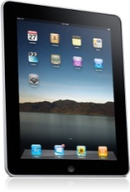
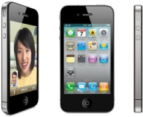

Consumer driven changes
1
2
Catch up Video has found a home in NZ
New platforms are becoming viable
Notes:
There are three key consumer forces at work that have influenced our FY12 strategy
Online video’s rapid adoption
New platforms like mobile and connected TVs are now viable options
Content no longer has to come from your own site

Slide 5
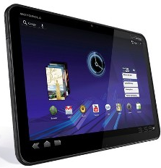


2
New platforms are becoming viable
Mobile
Connected TV
There are 726,000 smart phones in NZ
Over the next 12 months Samsung alone will sell 70,000 internet and wifi capable TV sets
During 2010 connection speeds doubled - average data consumption doubled.
In US Retail Stores TV buyers were asked “Why are you upgrading your TV?”
So far over half of that data was video with a CAGR of 92%
Reason to Upgrade | 2009 | 2010 | 2011
LED | 2% | 23% | 57%
Connected TV | 8% | 19% | 27%
Source: Cisco, LG Electronics, Telecom and Samsung (confidential)
Notes:
Another trend is the emergence of workable models for mobile TV and Connected TVs.
Mobile:
There are four key success factors with Mobile Video
1. Devices with the right screens and battery
2. Networks with enough connection speeds
3. Networks with the right bandwidth pricing
4. Content rights availability
In today’s market these exist and it is being expressed in the growth of smart devices, the doubling of the data consumption yoy and dominance of video in the make up of that data (50%)
TV:
Talk about the tyranny of the last metre now being overcome by the new Samsung TV’s. The question is that now we have the technology is there the consumer demand? If we look at US data for exit interviews of TV purchasers at retail, nearly one third of them ranked connected TV as the main reason for upgrading.

Slide 6

Consumer driven changes
1
2
3
Catch up Video has found a home in NZ
New platforms are becoming viable
Embedding, sharing and syndicating is driving video growth
Notes:
There are three key consumer forces at work that have influenced our FY12 strategy
Online video’s rapid adoption
New platforms like mobile and connected TVs are now viable options
Content no longer has to come from your own site

Slide 7
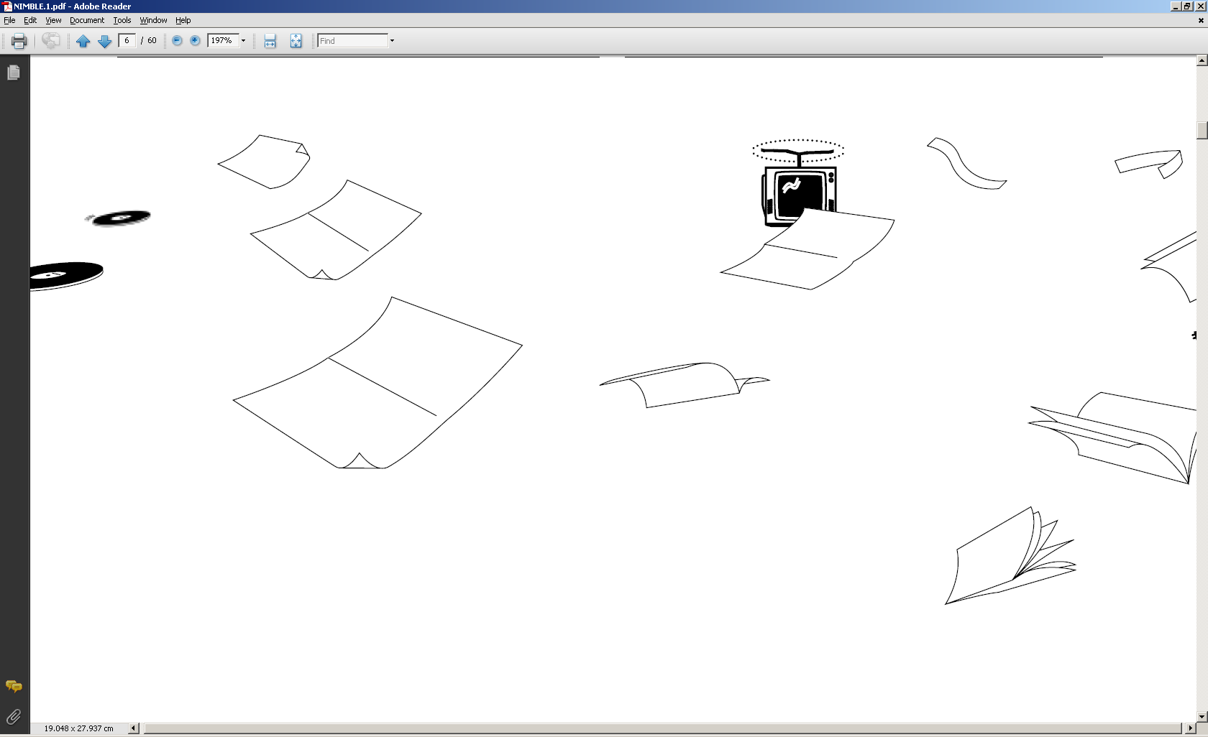

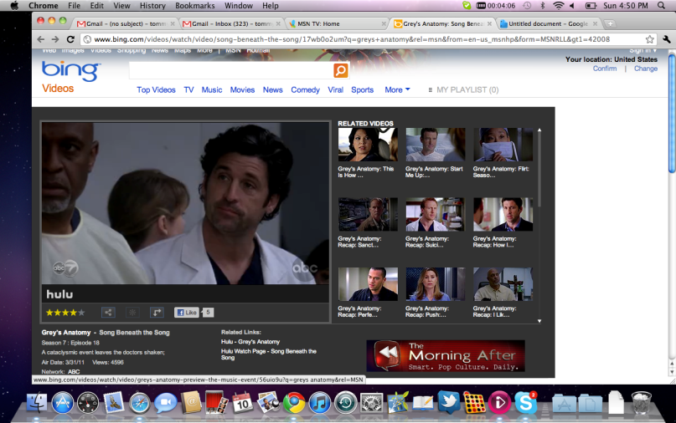
3
Embedding, sharing and syndicating is driving video growth
40% of Hulu’s video’s don’t start on Hulu.com
12% of Brightcove’s streams come from Facebook
40-60% of Youtubes’s video’s don’t start on Youtube.com
Notes:
The third major influencer is the rate at which content is being shared, embedded within new sites and consumed in new environments.
This is substantiated by youtube….Hulu……
The challenge is how do we create a platform to allow and control this?
So – Video is here to stay and will only get stronger
Its finding its way to TV’s and Mobiles quicker than ever before
And its finding its way to users without the need for the usual containers of the content owners website

Slide 8

Customer driven changes
1
Digital Ad expenditure accelerated in FY11

Slide 9
1
Digital Ad expenditure accelerated in FY11
+23%
+15%
+16%
Total Market Digital Revenue $m
Source: IAB PWC Online quarterly reports
Notes:
Notes:
The final quarter of the FY11 year is an estimate using historically trending of the % of dollars in this quarter
These figures have three categories included
Display 31% share
Classifieds 31% share
Search 37% share
Display total expenditure is $90m and we estimate will grow at 28% for the full year (has grown at 30% for the first 3 quarters of our financial year FY11)
As per slides later in the doco Display is growing at the fastest rate, then Search, then Classifieds (but all are growing)
IAB figures are NET (include commission) therefore TVNZ is slightly under represented

Slide 10

Customer driven changes
1
2
Digital Ad expenditure accelerated in FY11
Video is out growing any other form of Digital expenditure

Slide 11


2
Video is out growing any other form of Digital expenditure
+55%
+49%
+
+52%
est
YOY growth % FY11 Q1-Q3 vs STLY
*included within Display
Source: IAB PWC Online quarterly reports, Growth across 3 quarters (FY10 Q1-Q3 vs FY11 Q1-Q3) / Australia: IAB, US: eMarketer, TVNZ: RMS
Notes:
Notes:
The figures are the for the first 3 quarters of FY11 versus STLY
The Q1 2011 calendar quarter is the first quarter the IAB have reported Video expenditure so we do not have an exact YOY growth % for Video
The 40%+ is an estimate based on the fact that TVNZ has a 59% share of the total reported figures and we are growing at 55%, this is also include with reported Video growth in Australia and US
Anecdotally the growth in display is being driven by performance networks attracting more advertisers given clear ROI metrics can be delivered, and the fact that Video is a sub-segment of the total Display category
Video is 10% of the Display expenditure which means whilst Video is growing much faster, all elements of Display (static) are actually growing.

Slide 12
Video Revenues vs Static Revenues
2
Video Revenues vs Static Revenues FY07 - FY12

Slide 13

Customer driven changes
1
2
3
Digital Ad expenditure accelerated in FY11
Video is out growing any other form of Digital expenditure
Advertisers continue to be influenced by size

Slide 14
3
Advertisers continue to be influenced by size
Unique Browsers, Top 10, June 11, (000)
Source: Nielsen Online (Market Intelligence)
Notes:
Notes:
Struggling to get onto the static schedules:
We don’t deliver the reach due to our size
We don’t deliver low level CPMs as we’re not big enough to make money this way
Data is all people but it is exactly the same picture on multiple demos

Slide 15


Customer driven changes
1
2
3
4
Digital Ad expenditure accelerated in FY11
Video is out growing any other form of Digital expenditure
Advertisers continue to be influenced by size
A glut of inventory continues to commoditise
static CPMs

Slide 16
4
A glut of inventory continues to commoditise static CPMs
Average display CPM : New Zealand
Average display CPM : International
-43% last 3 yrs
-46% last 3 yrs
Source : Starcom internal. Based on average standard display – specific environmental buys will attract premiums.
Notes:
Notes:
Premium: home pages or premium pages on sites
Network: ROI on sites or buying via a network group (i.e Google etc)
International: buying NZ eyeballs on International sites either direct or via a network group
Starcom suggesting that CPMS have already dropped further in FY11 and they are getting performance campaigns away at around $1 CPM, driven by large sites/ networks such as Google and Trade me selling at 50c CPM.
Figures are net net

Slide 17

FY11 performance reflects the market and our position.

Slide 18
Video (Ondemand) was TVNZ’s star performer
FY11 YOY Growth TVNZ Digital Revenue %
Source: TVNZ RMS
Notes:
Notes:
Our total expenditure growth was 14%
Actual dollars figures are:
Total $7.257m (vs $6.369 LY) so +$878K
Video $4.689m (vs $3.004 LY) so +$1.685m
Static $2,568m (vs $3,296 LY) so -$728K

Slide 19



Video success driven by a clear sales strategy
SHARE
Dominated share of revenue at 59% of reported dollars
CPM premium held at 47% over TVWorks
Sell out rate of 74% achieved
Launch of Ad on Pause
Launch of Adselector
Source: share: IAB/ CPM: market intelligence / sell out: RMS
Notes:
Notes:
Share at 59% is an estimate for the full FY11 based on actual share in Q1 2011 calendar in the IAB report
CPM is from Starcom’s buys of TVWorks at $90 CPM on their ondemand
Launch of Adselector xxxxx
Launch of Ad on Pause

Slide 20

Our FY12 strategy plays to our strengths and capitalises on market trends
VIDEO

Slide 21
Digital Media strategy for success
FISCAL
Transform Digital Media
Increase video consumption and sponsorship assets
Reduce investment into and risk profile of static assets
Eliminate unprofitable activities
EXTERNAL
Be the market leader in integrated customer engagement for advertisers across TV and digital
Be the market leader in online video advertising solutions
INTERNAL
Implement a P&L structure with true cost and revenue
Create a clear and communicated GTMS for DM focused on, but not limited to, video and sponsorship
Lift video consumption in news and TVNZ Ondemand by 40% and 20% respectively
Lead the market with key video syndication partnerships
Reduce or redeploy resources allocated to static
Only create static if it is a profitable component of a sponsorship and a pathway to video
LEARNING & DEVELOPMENT
Ring fence costs for the delivery of marketing and public service components of digital media
Reshape planning and relationship with Sales
Ensure DM is an integrated component of TVNZ’s marketing communications
Video platform upgrade: improve automation, roadmaps and monetisation of the video platform
Drive a campaign for the unmetering of 20% of NZ’s broadband population
Review content production tools and processes to reduce overhead required to create content
Notes:
So our FY12 overarching strategy is how do we transform Digital Media to respond to these market changes.
This is supported by the top three themes of:
increasing video consumption and sponsorship activities.
Reducing our exposure to further reduction in static CPMS
Eliminating unprofitable activities.
We want to be seen as continuing to be the market leader in integrated engagements and video advertising solutions.
In order to achieve this we must drive deliver two major supporting activities;
A new Online Video Platform to enable new platforms and places
A full review of static content production and sources to reduce the overhead required to create it

Slide 22
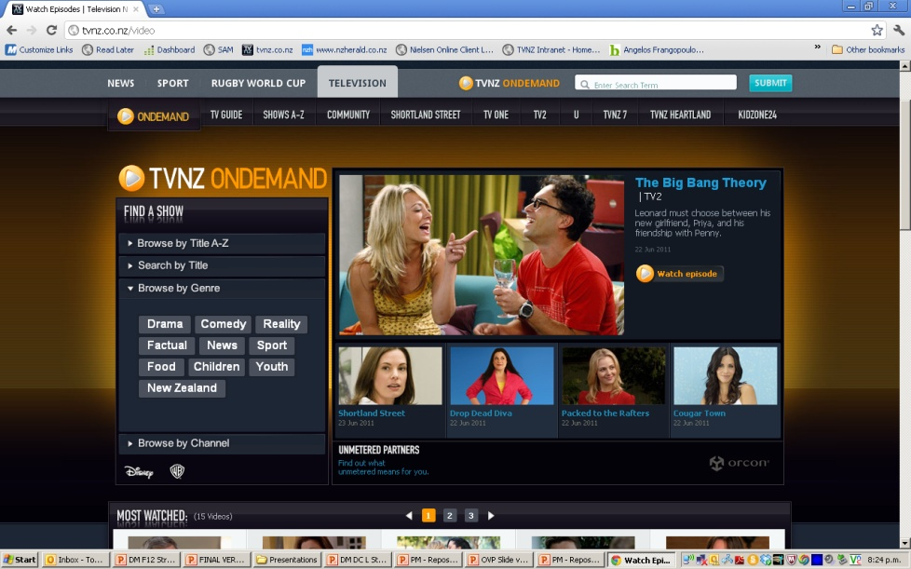
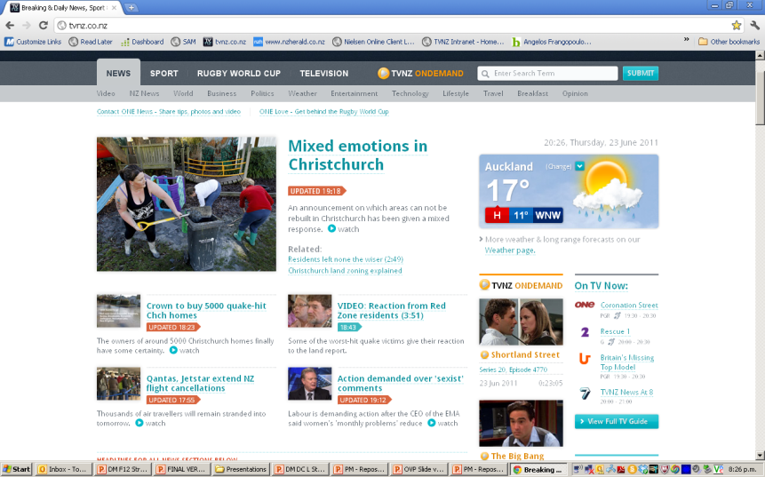
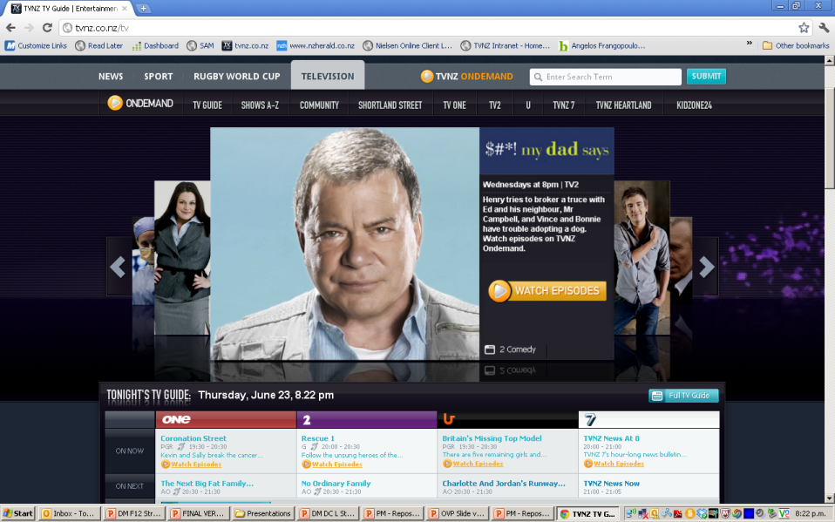
To support the strategy and deliver the revenue we have a Gameplan for each product
Ondemand
News
Entertainment
Syndicate and Embed for reach
Distribute to Mobile and OTT devices
Syndicate and Embed for reach
Breaking news video
Focus resources on commercial Integrations
Driving users to TVNZ Ondemand
Gameplan initiatives
Notes:
Ondemand:
ABC Australia (who have an un-DRM’d ondemand service to iPad) claim 5% of their ABC iview traffic comes from iPad.
News:
Access to immediate breaking news video is becoming more and more common as we arm reporters with more video capable phones and the Newsroom is better equip to deal with viewer generated footage. Incidents like the Albany tornado created 6 pieces of content that collectively did hundreds of thousands of views.
Entertainment:
Changes to content policies and navigation have increased the pass through of users to TVNZ OD from the website by X%

Slide 23
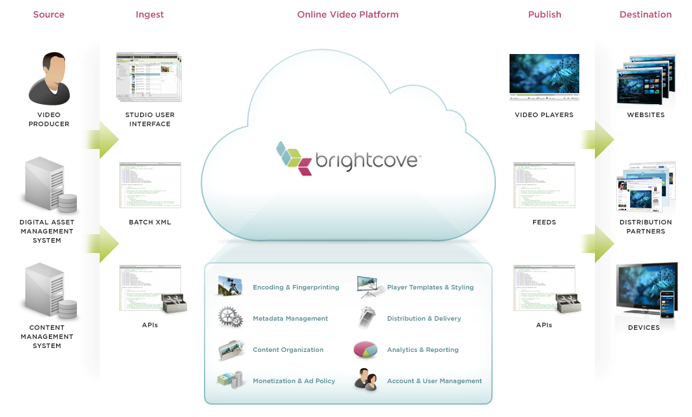





In order to realise the strategy above we have outsourced our Online Video Platform to best of breed suppliers
SOURCE
PREPARE
TRANSCODE
DELIVERY AND OPS
DELIVERY
CURRENT OVP
Nexus
Process intensive with bespoke systems
16 different bespoke players and ad units, flaky CDN, weak analytics
PC and PS3 only
OUTSOURCED OVP
Nexus
Best in class video workflow and transcoding
Best in class player and ad units, CDN and analytics
Notes:
EK – Not sure how you want to pitch this now.
My thoughts.
We will cross the boundary to positive contribution
BIG Note: FY12’s costs included all internal recharges
FY12 Headcount is 22.5% down on FY11
Static is only 29% of the $9.4m in FY12
Cost increases have stabilised and will reduce in FY13 and 14 because of $3.5m of depreciation has come to an end and CDN costs reducing

Slide 24
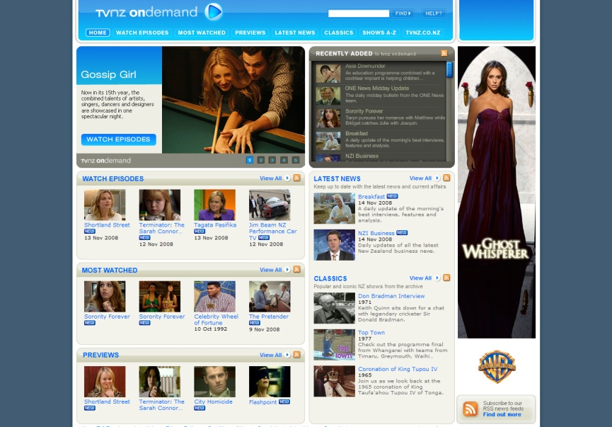







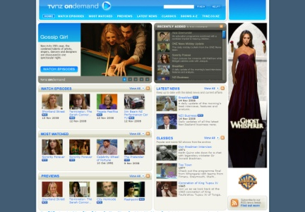




TVNZ Ondemand FY12 high-level roadmap
Jul |  | Aug |  | Sep |  | Oct |  | Nov |  | Dec |  | Jan |  | Feb |  | Mar
Launch OVP:
on
on
&
syndicated to
3000kbps
300kbps
700kbps
on
Adaptive Streaming
on
ISP Un-metering Initiatives and Bandwidth Usage Customer Awareness Program
Notes:
Testing during the RFP showed that users on Akamai had buffering and performance issues reduced by 15%
Adaptive streaming will improve the end user experience and virtually put an end to bufering
Samsung deal which has yet to finish terms has already secured $377k in exclusive TV spend. Subsequent to the terms being agreed it will guarantee $850k exclusively to TVNZ including them funding the $80k build for the application. Samsung spent $200k last year.
Embedding the player within Facebook increases the click through by 50 times
iPad and iPhone – We get as an out of the box solution from Brightcove (total annual licence fee of $180k) – Incredibly difficult to achieve technically. We cost this as a build of at least $700k to do it by ourselves.
Android is 22% of the NZ Smartphone market
Un metering efforts are still at play but will become less and less important as time goes on – already Telecom doubled their home data caps this week. In Oz Telco’s have been increasing packs from 10Gb t6o 150Gb over night for customer bases.
has come to an end and CDN costs reducing

